Slide 1


Commercial Desktop, Gerald Hsiao

Slide 2
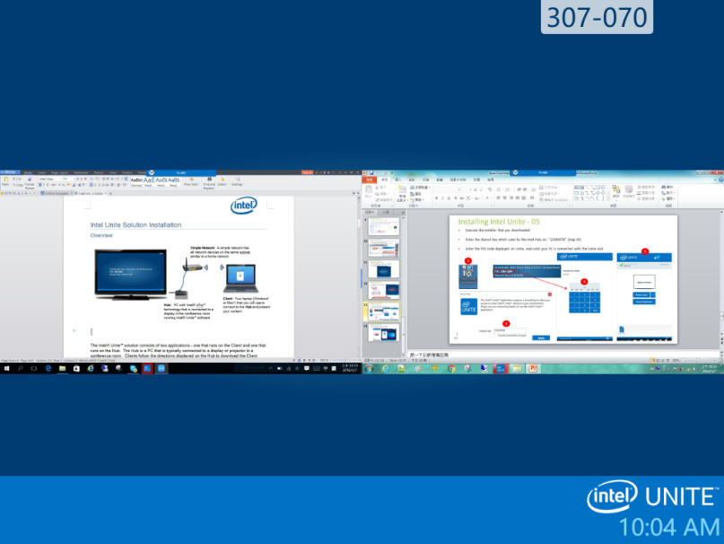
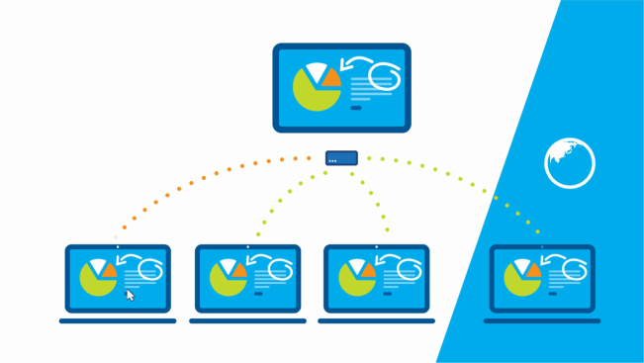
Intel Unite – Smart, Secure Conference Room Technology
Shared Screens without Wires
Connect attendees to existing displays or projectors without wires
Instantly share screens on one display (up to 4 screens on one HUB)
Collaborate in Real-Time
Attendees can view, annotate, and share documents
Safer Meetings
Join a meeting by entering a PIN code
Protected Data
256-bit SSL encrypted, data always stays within the company network
Up to 4 screens can be shared on one Intel Unite HUB
Notes:
https://www-ssl.intel.com/content/www/us/en/architecture-and-technology/unite/intel-unite-overview.html
http://www.intel.com/buy/us/en/audience/unite/

Slide 3
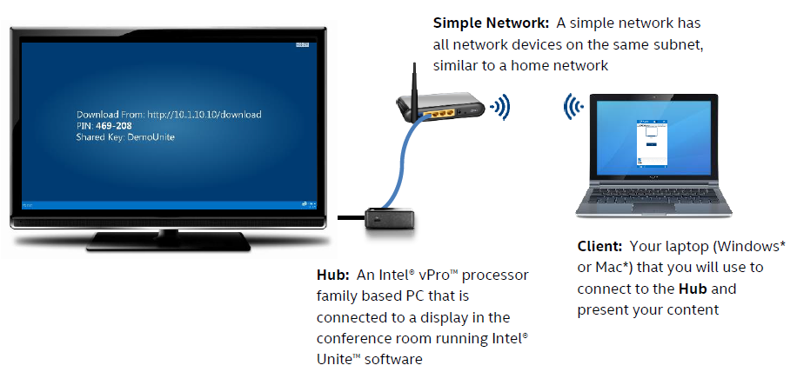
Intel Unite – How it Works?

Slide 4
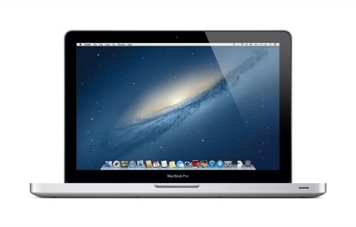


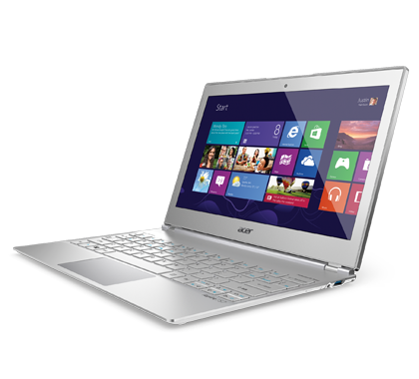
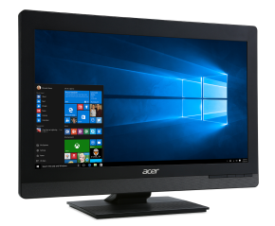
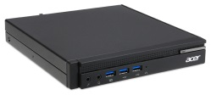
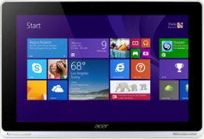
Intel Unite - System Requirements
Wireless
Hub | Client
Intel vPro processor family based PC 4 GB RAM 1 GB available storage Microsoft Windows 7, 8, 8.1 or 10 Microsoft .NET 4 or greater Wired or Wireless Network Connection Customized OEM Strings in BIOS | At least 1 GB RAM At least 1 GB available storage Microsoft Windows 7, 8, 8.1 or 10 Microsoft .NET 4 or greater Apple Mac OSX 10.9 or greater

Slide 5
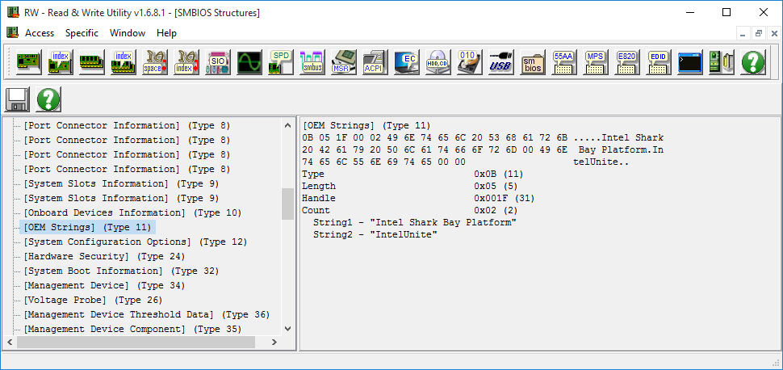
Intel Unite – BIOS Requirement
Intel Unite requires OEM Strings in BIOS type 11, set String2 to “IntelUnite”

Slide 6

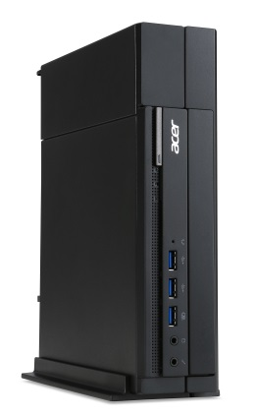

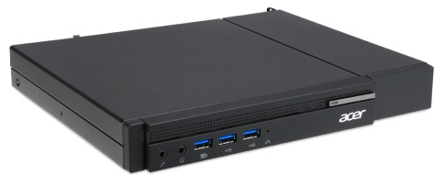
Intel Unite - Bundle Policy
Preload Intel Unite standalone HUB on vPro capable mini-PCs and All-in-One, starting from vIronbox (VN6640G) and vWoody238 (VZ6820G)
Available in 2016 Q2
Support W7, W10, and new Windows release
Install Intel Unite in Acer ControlCenter -> Software Assembler

Slide 7
ODM Validation for Intel Unite
HUB * 1 (The system which Intel Unite HUB is running on)
BIOS OEM string “IntelUnite” should be in place
Install Intel Unite HUB from Acer ControlCenter and can open it successfully (show the landing screen with URL/PIN/Shared Key)
Client * 2 (any Windows PC connected to the same subnet with the HUB system)
Can download Intel Unite client from the URL displayed on HUB, and can install the client successfully
Can successfully join a meeting and share screen / make annotation / share files to other attendees

Slide 8
Remarks

Slide 9
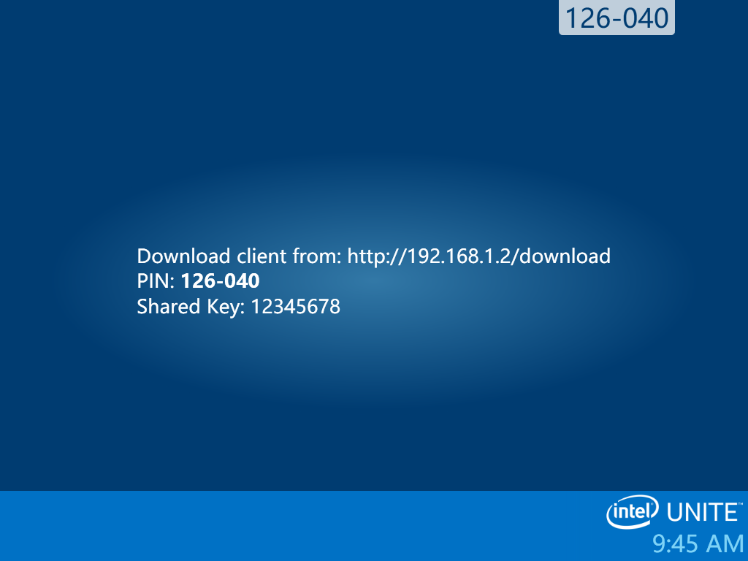
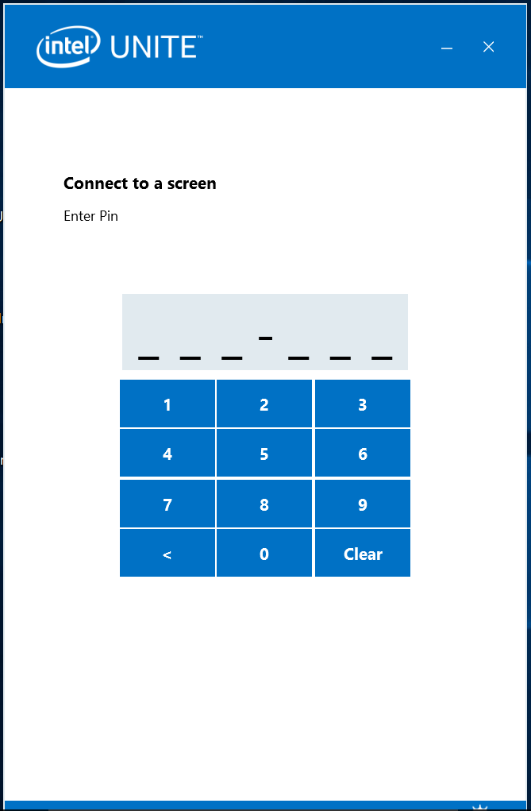
Intel Unite – Landing Screen on Unite HUB
Back
Unite HUB
Unite Client
Download Unite Client via browser
Install Unite Client on any attendee’s PC
Connect the client and HUB with PIN and shared key protected

Slide 10

Intel Unite – Sharing screens on one Display
Back

Slide 11
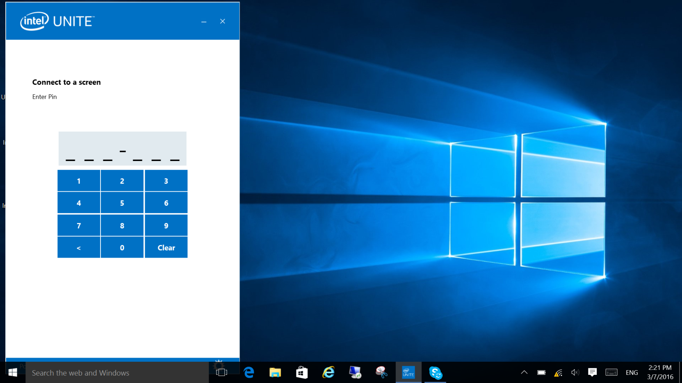
Intel Unite – Join a Meeting 01 (Enter PIN code)
Back

Slide 12
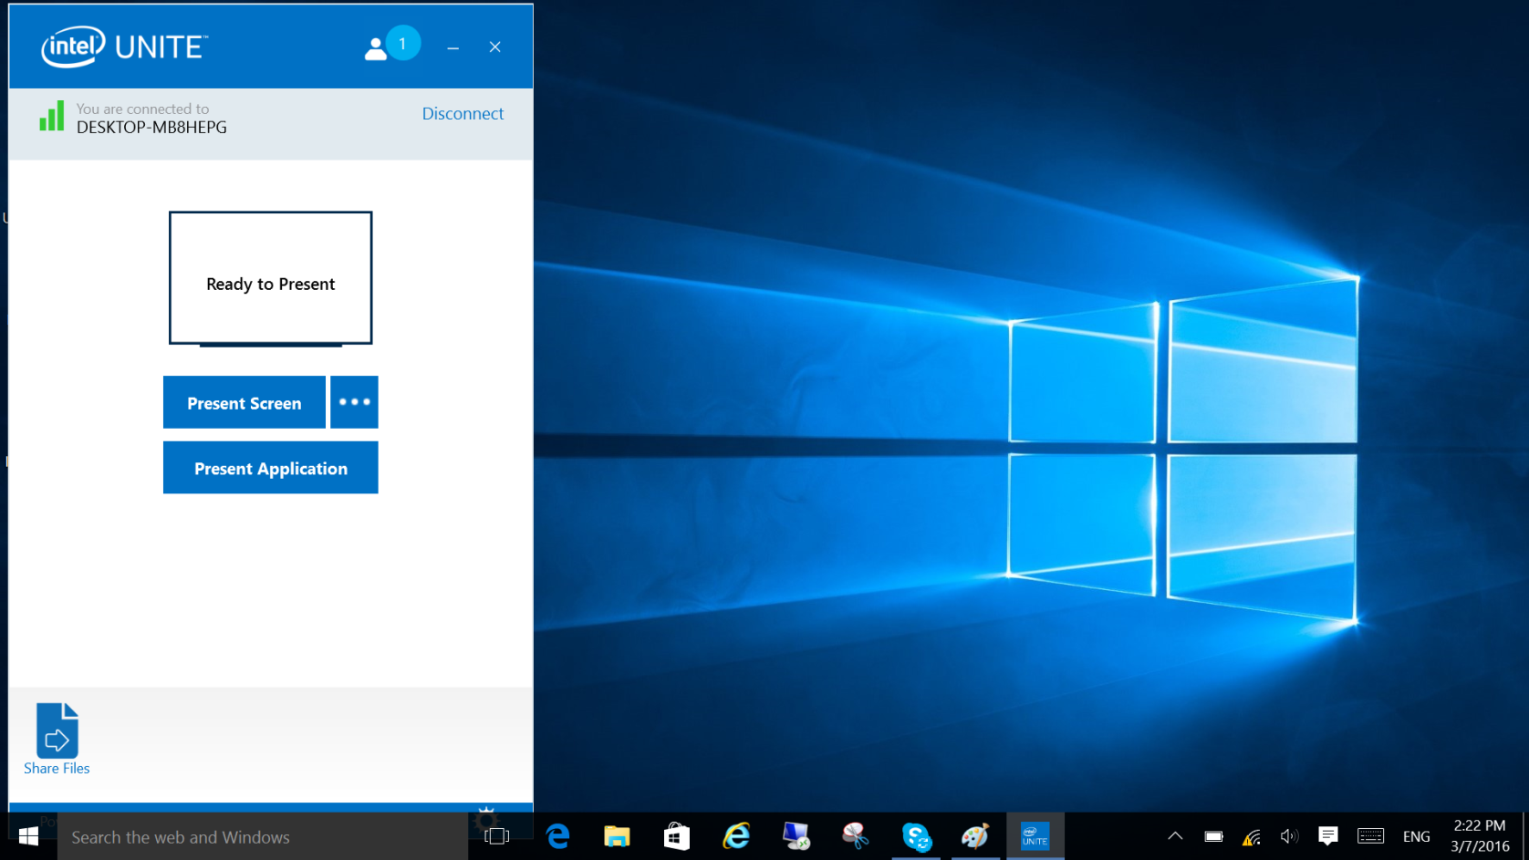
Intel Unite – Join a Meeting 02 (Connected to HUB)
Back
Ready to share your screen to other attendees
Offer P2P file sharing

Slide 13
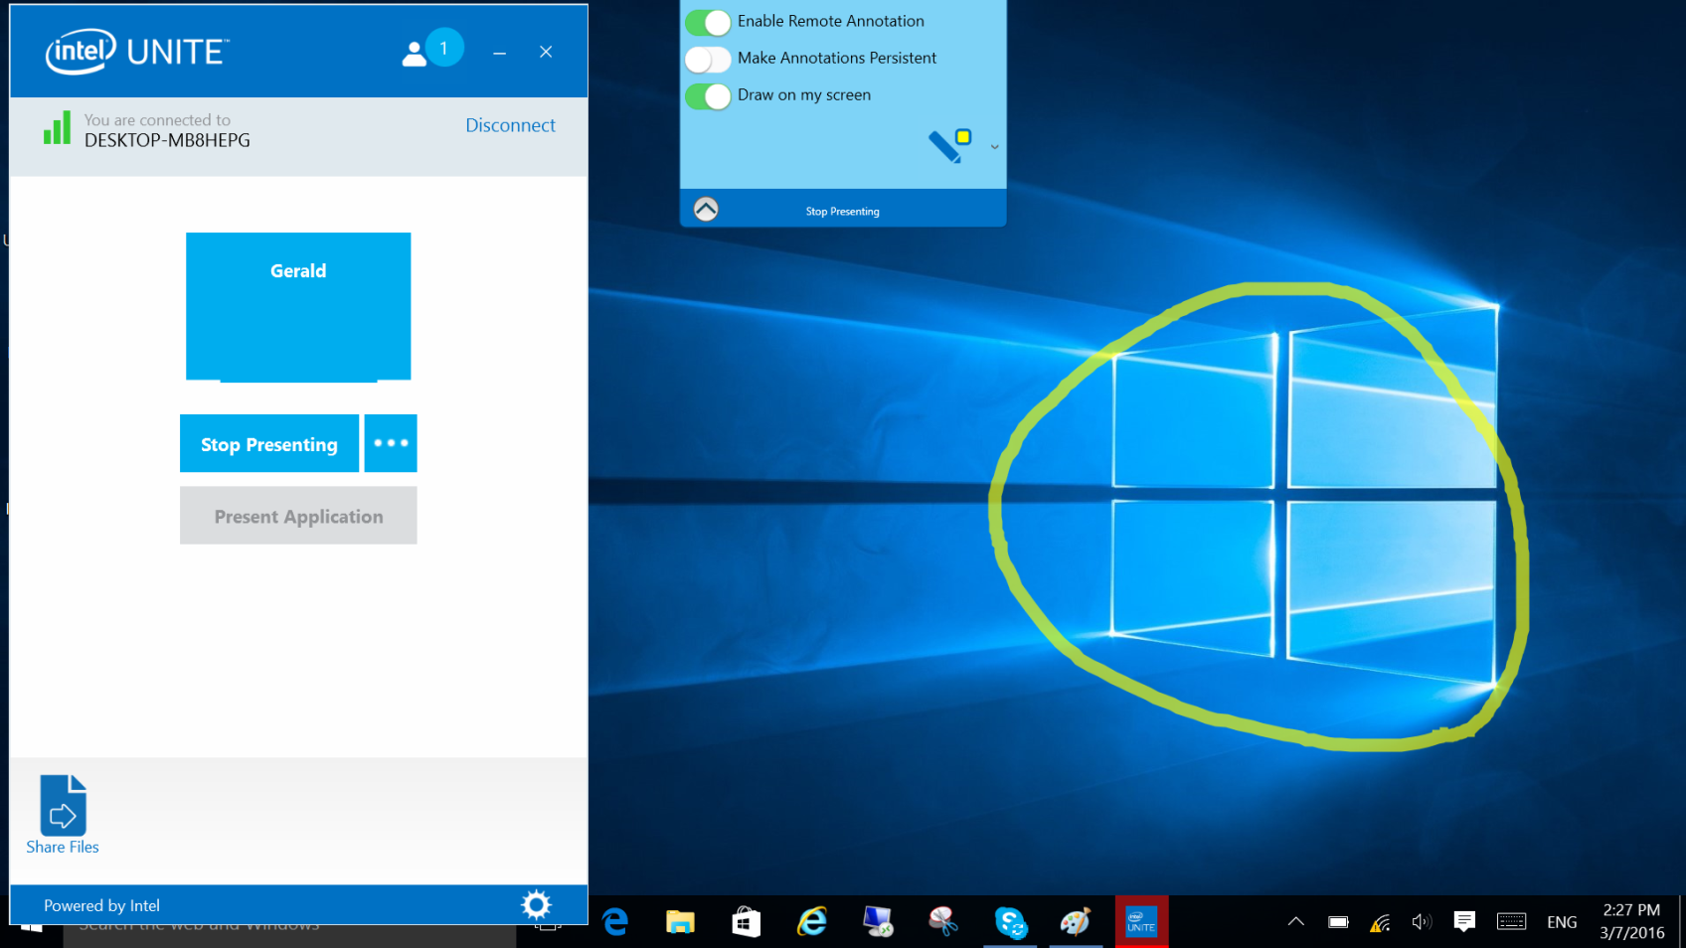
Intel Unite – Join a Meeting 03 (share screen & make annotations)
Back

Slide 14
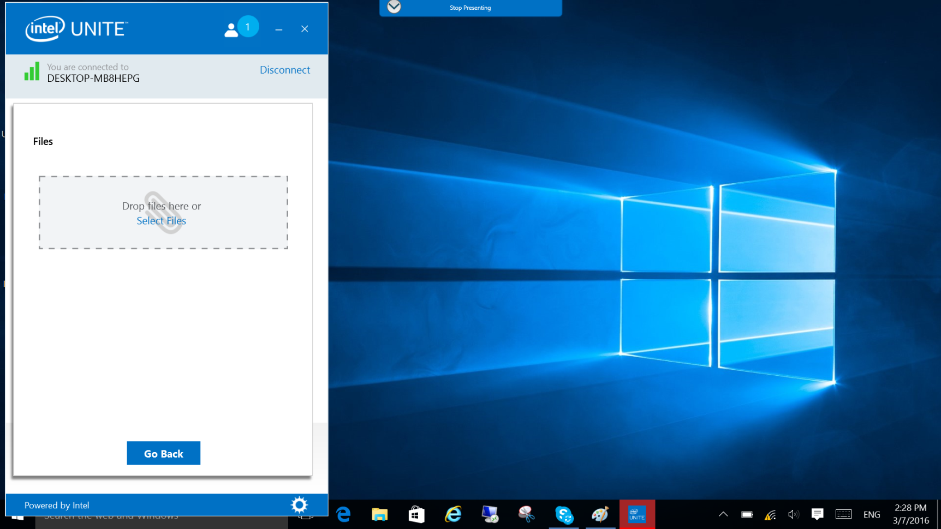
Intel Unite – Join a Meeting 04 (share files to other attendees)
Back

Slide 15
Install Intel Unite Client & Connected to HUB

Slide 16
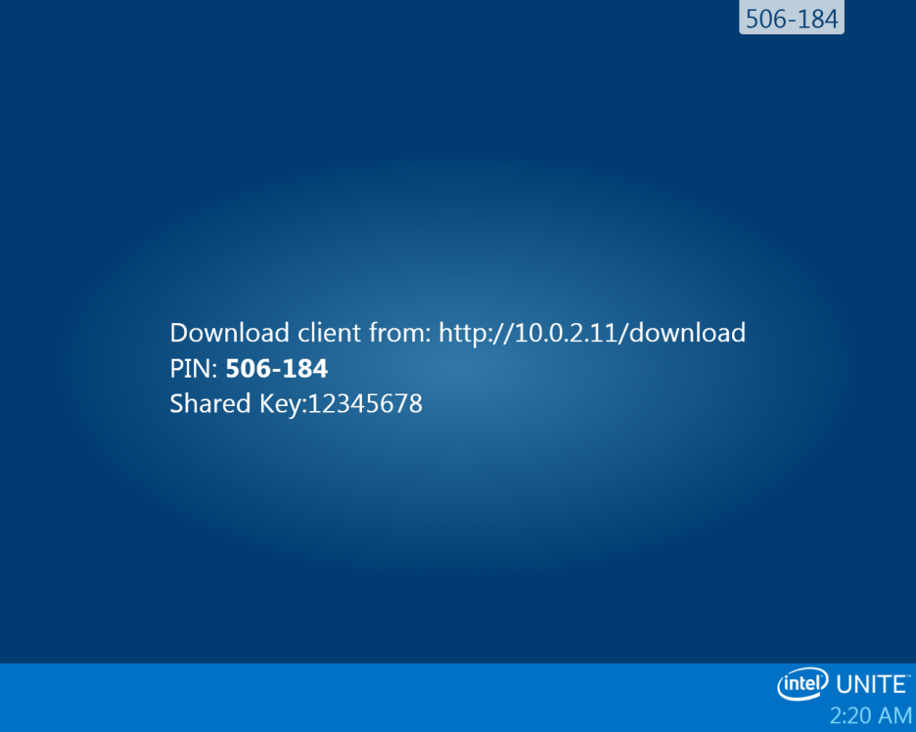
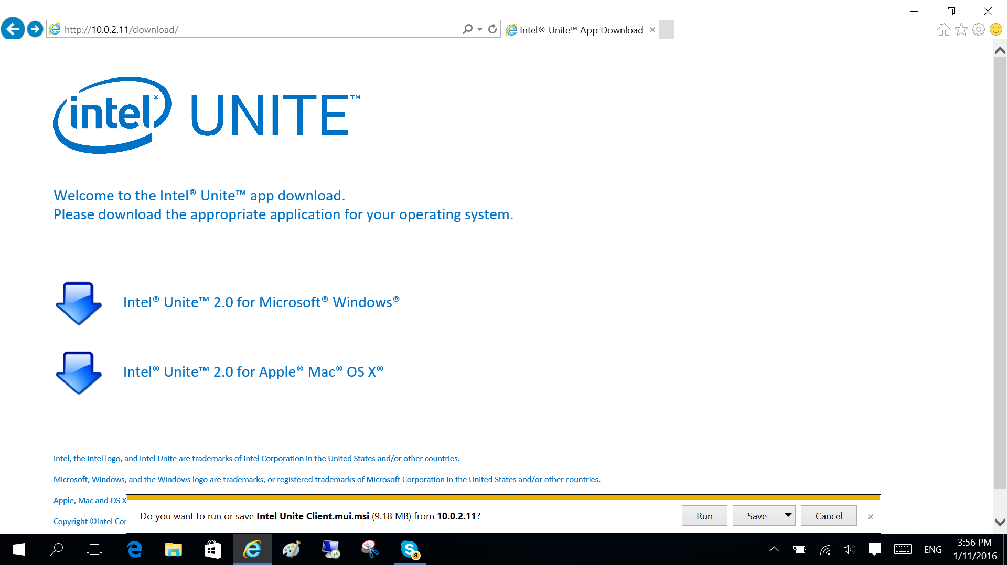
01. Installing Intel Unite Client
Prepare another Windows system and connect it to the WLAN
Open the browser and link to the URL show on Unite
Download the build
2
1
3
4

Slide 17
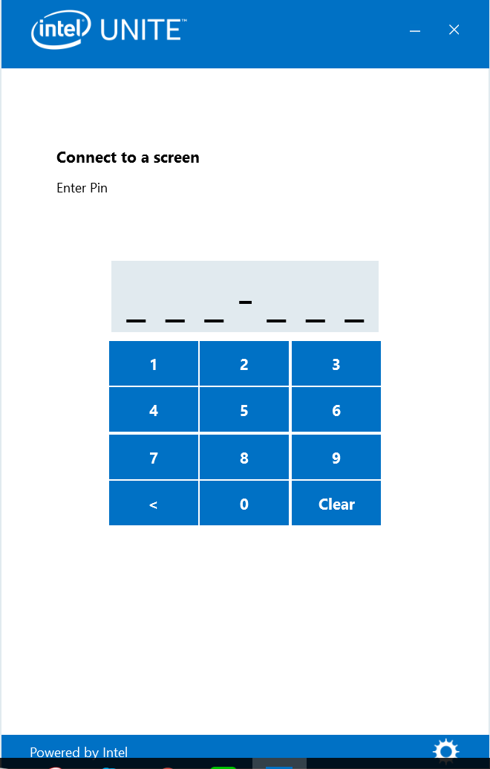
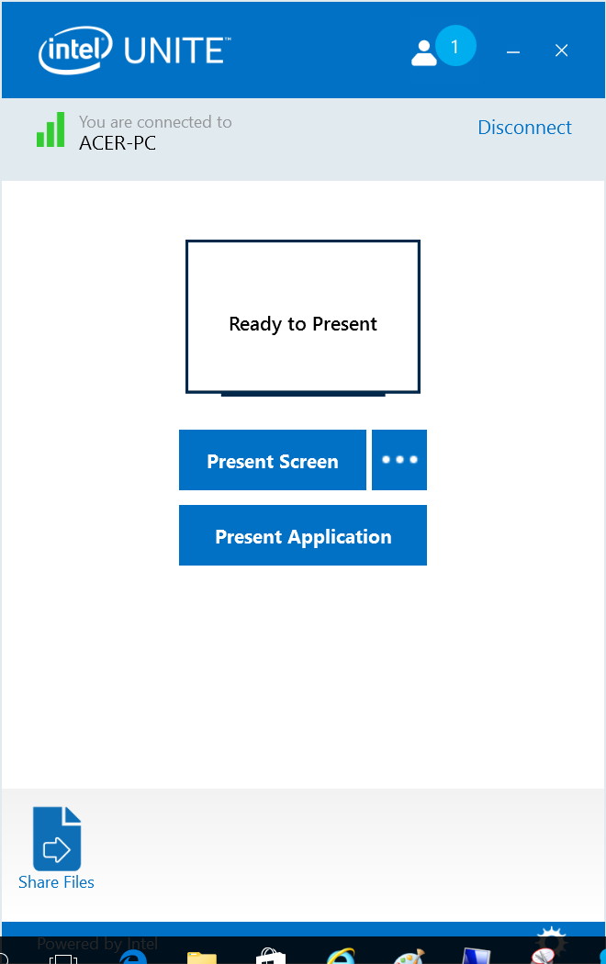
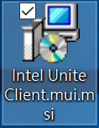

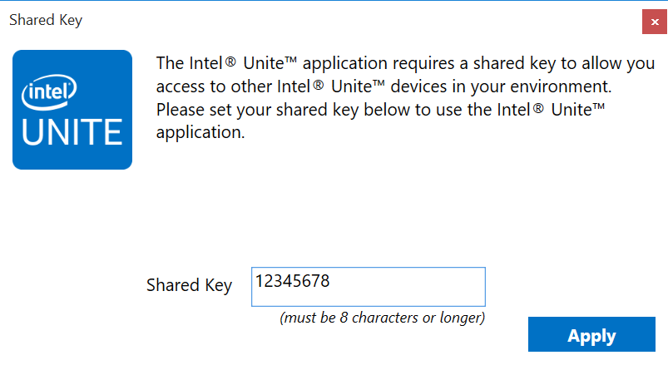
02. Connect the Client to the HUB
Execute the installer that you downloaded
Enter the shared key which used by the Intel Hub, ex. “12345678” (step 03)
Enter the PIN code displayed on Unite, wait until your PC is connected with the Unite Hub
4
1
3
2

Slide 18
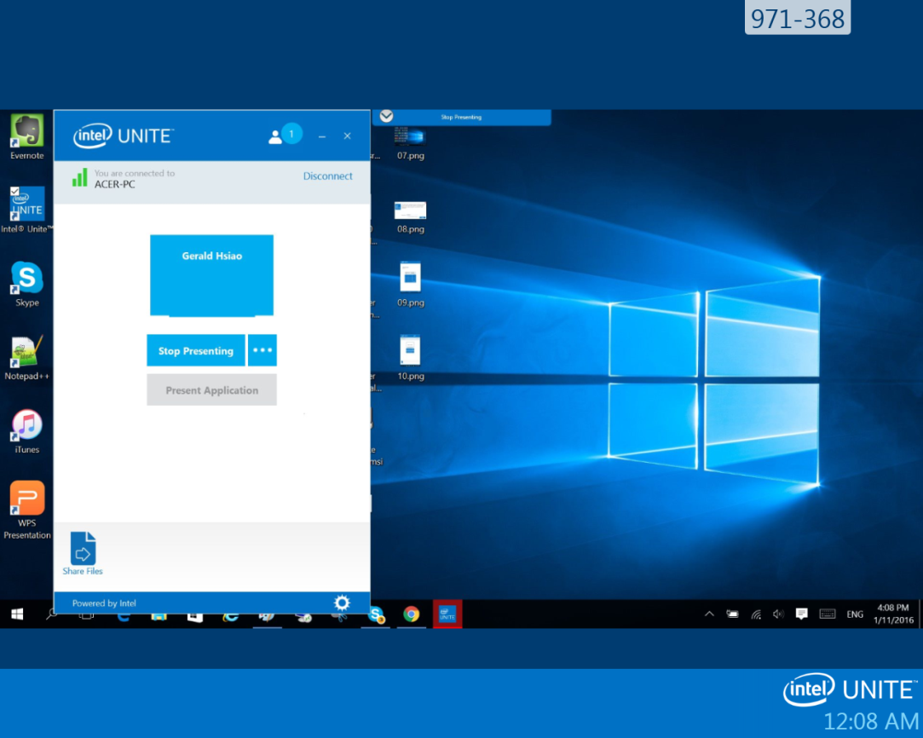
03. Sharing screen to the HUB
Clicked the “Present Screen” button on the client system
On Unite Hub, show the screen of the connected device
2
1

Slide 19


